Slide 1
Checking account – An account held at a bank, credit union, or other financial institution in which account owners deposit funds.
Account owners have the privilege of writing checks on their accounts and are able to use ATM cards and debit cards to access funds.

Slide 2
Savings account – An account at a bank, credit union, or other financial institution in which account owners deposit funds.
Account owners are paid interest on the amount deposited in their accounts.
Account owners have the ability to withdraw funds but do not write checks on these accounts.
The number of withdrawals in a given period of time may be limited.

Slide 3
Thumbs-Up or Thumbs-Down?
a
People are able to make deposits to and withdrawals from both savings accounts and checking accounts.
b
Check-cashing services charge minimal fees for cashing checks.

Slide 4
Thumbs-Up or Thumbs-Down?
c
People with a savings or checking account are usually able to cash checks for free or a small fee (less than a few dollars a month) at the bank where they have an account.
d
There are fees associated with checking accounts.

Slide 5
Thumbs-Up or Thumbs-Down?
e
Savings accounts pay interest on the balance of the account.
f
It isn’t legal for companies to require employees to use direct deposit.
g
With a checking account, you can write checks to pay for many types of goods and services.

Slide 6
Thumbs-Up or Thumbs-Down?
h
There are no fees associated with savings accounts.
i
You may use an ATM or debit card with both savings and checking accounts.

Slide 7
Thumbs-Up or Thumbs-Down?
j
Check-cashing services are open more hours than banks and credit unions and have convenient locations.
k
Banks and credits unions are safe places to keep your money.

Slide 8
What would you do if your employer didn’t require direct deposit? Would you open a checking or savings account, or would you use a check-cashing service? Why?
Suppose your company requires direct deposit and you open a checking account. How will you know how much money is in the account, particularly as you begin to withdraw, spend, and make additional deposits?

Slide 9
If you want to keep track of the money in your account, what information do you need?
The amount and date of each
deposit
withdrawal (including from an ATM)
automatic payment
check written
purchase with a debit card

Slide 10
How could you keep track of the money moving in and out of your account—that is, your financial transactions?
Possibilities include the following:
Computer spreadsheet
Computer program
Phone app
Notepad

Slide 11
Bank account register – A table in which account holders record their financial transactions to keep track of their money.
Online banking services – Services that allow account holders to use the Internet to transfer money electronically and view all of the financial transactions for their accounts, including all deposits and withdrawals.

Slide 12
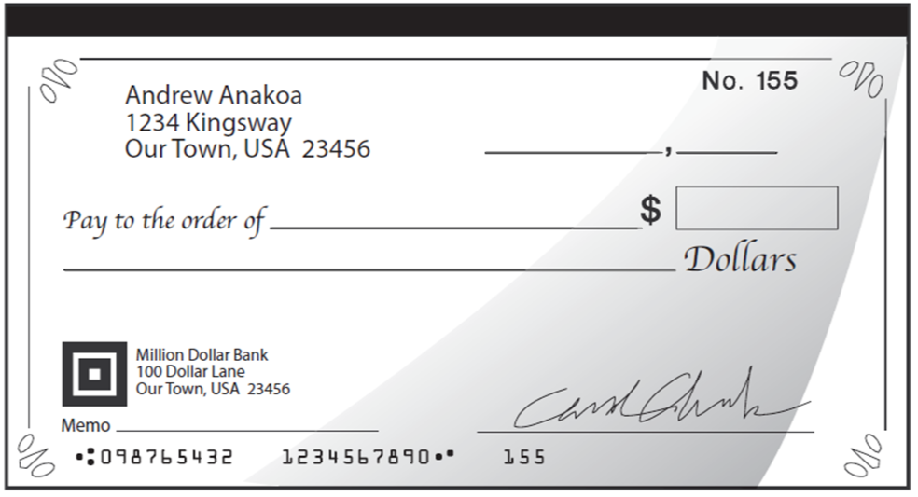

Slide 13
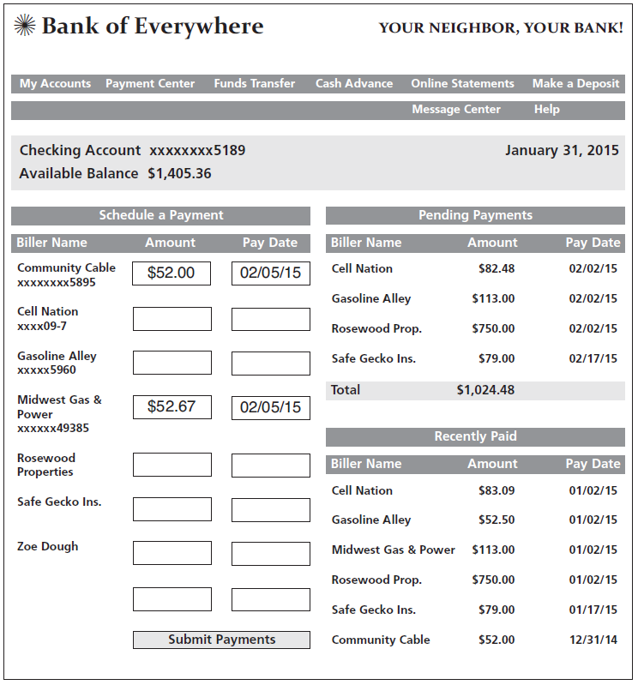
John Dough's Online Bill Payment Center

Slide 14
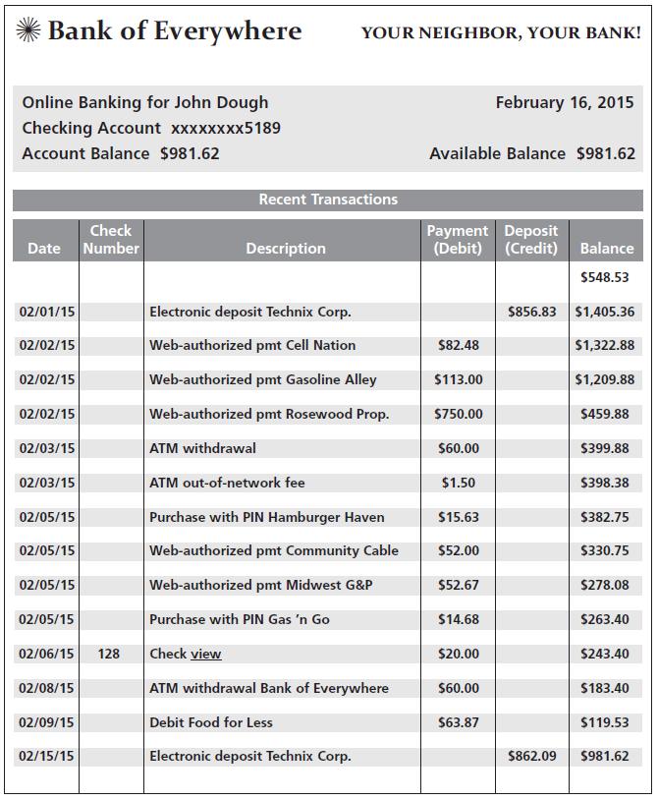
John Dough's Online Recent Transactions List

Slide 15
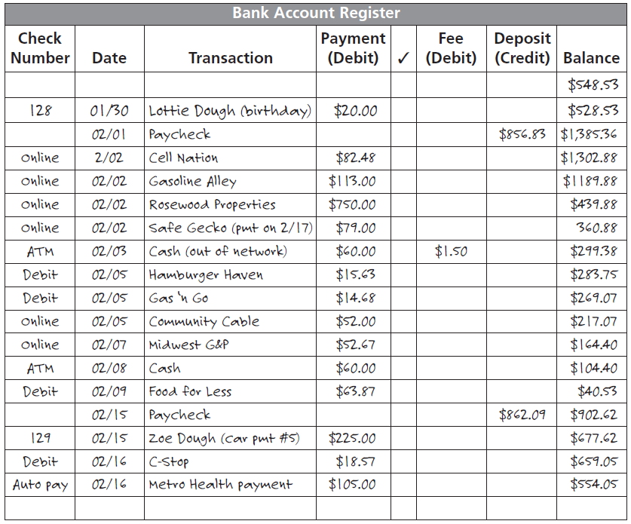
John Dough's Bank Account Register

Slide 16
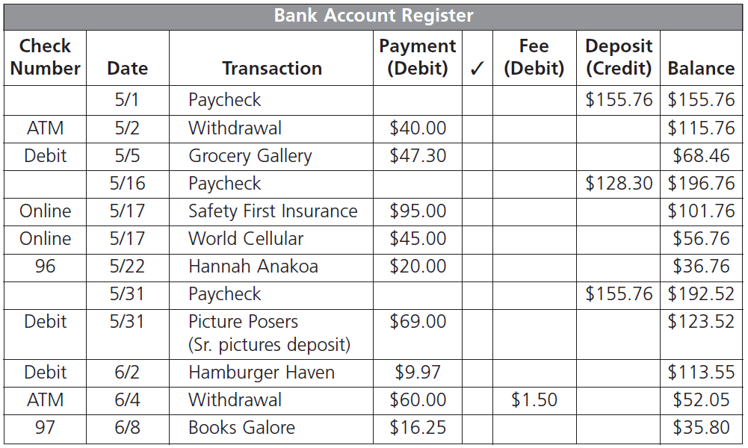
Handout 3.4: What’s the Balance?—Answer Key

Slide 17
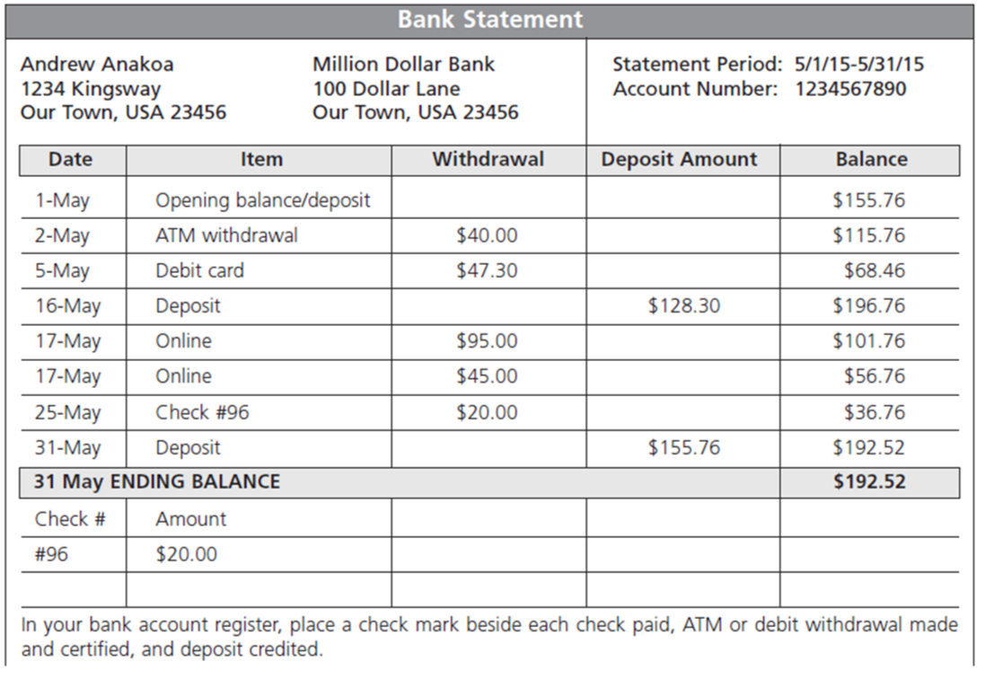
Balancing Andrew Anakoa’s Bank Account

Slide 18
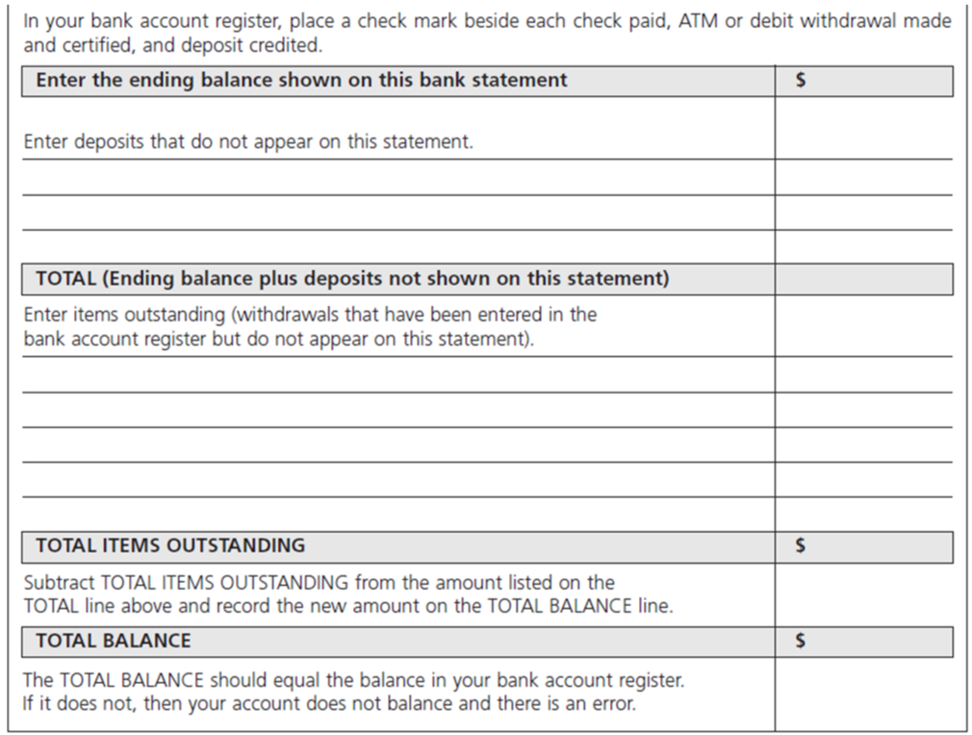
Balancing Andrew Anakoa’s Bank Account (cont.)

Slide 19
What are some advantages of having a checking or savings account?
Money is safe in a bank.
Money deposited may earn interest depending on the type of account.
There are low or no fees for cashing checks.
Banks provide a record of transactions.
You likely have 24-hour access to your money through ATMs.

Slide 20
What is a disadvantage of using check-cashing services?
Their fees are very high.
Why is it important to maintain account records and keep track of bank account balances?
To avoid paying overdraft fees, to make certain the records are accurate and show the correct balance, and to know where your money is going

